Slide 1
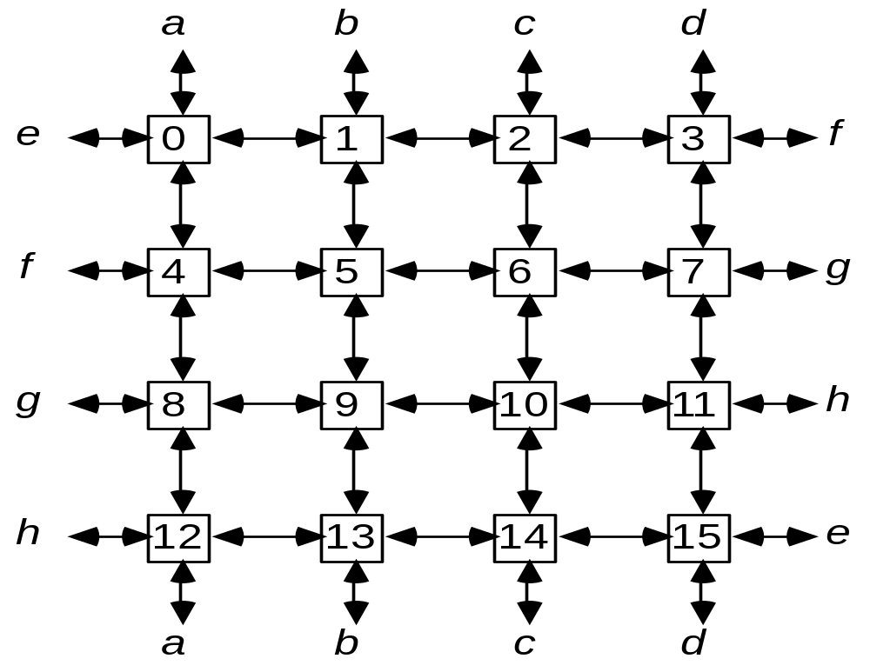
Mesh interconnection network (ILLIAC IV N/W)

Slide 2
In the Illiac IV, each processor i was connected to processors:
{i+1, i–1, i+4, and i–4} (mod 16).
Here are the routing functions:
R₊₁(i ) ≡ (i + 1) mod N
R _{–1}(i ) ≡ (i – 1) mod N
R_{+r} (i ) ≡ (i + r) mod N
R_{–r} (i ) ≡ (i – r) mod N where r = √N
Where 0 ≤ i ≤ N -1.
The permutation cycles:

Slide 3
The diameter of an Illiac-IV mesh is √N – 1. For example, in a 16-node mesh structure, it takes a maximum of 3 steps.
Chordal Ring N/W is ILLIAC-IV n/w. Also called as partially connected n/w. (Diag.)

Slide 4
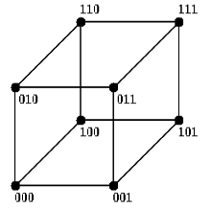
Hypercube
A hypercube is a generalized cube. In a hypercube, there are 2^{n} nodes, for some n. Each node is connected to all other nodes whose numbers differ from it in only one bit position.

Slide 5
Barrel shifting network:
A barrel shifter is sometimes called a plus-minus- 2^{i} network.
Routing functions:
B_{+i} (j ) = (j + 2^{i}) mod N
B_{–i} (j ) = (j – 2^{i}) mod N
where 0 ≤ j ≤ N– 1 and 0 ≤ i < log₂N.
B₊₀, B₋₀, B₊₁, B₋₁, B₊₂, B₋₂, B₊₃ and B₋₃
In general, the diameter of a barrel shifter is (log₂N)/2.

Slide 6
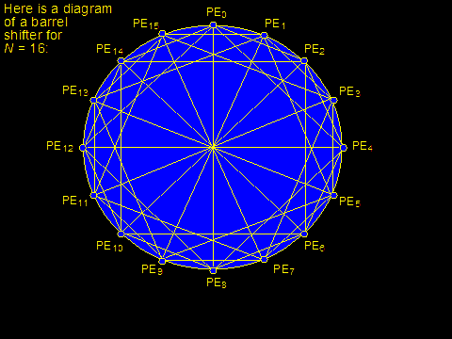
Here is the diagram for barrel shifter for N=16.

Slide 7
Comparing the Barrel shifter with mesh-connected n/w, the following equivalence is revealed when r=√N=2^{n/2}
B₊₀ = R₊₁
B₋₀ = R ₋₁
B_{n/2} = R_{+r}
B_{-n/2} = R _{-r}
Illiac Routing functions are a subset of Barrel-shifting functions. Instead of having just 4 nearest neighbors as in ILLIAC n/w, each PE in Barrel shifter is directly connected to 2n-1 PEs.

Slide 8
For N=16, the Barrel shifter has node degree of 7 with network diameter 2.
The minimum no. of barrel shifting function B is upper bounded by
B≤ log₂(N/2)
where N is the no. of nodes.
In ILLIAC n/w 4 PEs can be reached from any PE in 1 step, 7 PEs in two steps and 11 PEs in 3 steps.

Slide 9
PE₀ can reach PE₁ , PE₄ , PE₁₂ , and PE₁₅in 1 step. (ie 4 PEs)
PE₀ can reach PE₂ , PE₃ , PE₅ , PE₈ , PE_{11,} PE₁₃ , and PE₁₄ in 2 steps. (ie 7 PEs)
PE₀ can reach PE₂ , PE₃ , PE₄ , PE₆ , PE_{7 ,} PE₈ , PE_{9 ,} PE_{10,} PE₁₂, PE₁₃ and PE₁₄ in 3 steps. (ie 11 PEs)

Slide 10
In general, it takes I steps to route data from PE_{i} to any PE_{j} in ILLIAC of size N where I is upper bound by
I ≤ √N-1
The speedup of a Barrel shifter over ILLIAC n/w =

Slide 11
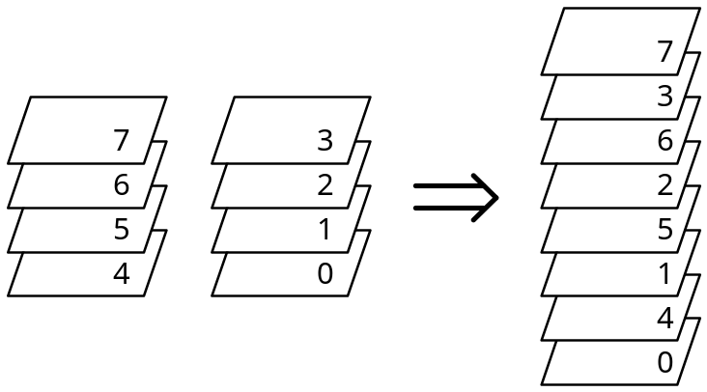
Perfect-shuffle interconnection:
This interconnection network is defined by the routing function
S (a_{n–1} … a₁a₀)₂ = (a_{n–2} … a₁a₀ a_{n–1})₂
It describes what happens when we divide a card deck of, e.g., 8 cards into two halves and shuffle them “perfectly.”

Slide 12
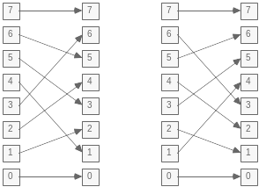
Perfect Shuffle
Inverse Shuffle
We can draw the processor interconnections required to obtain this transformation.

Slide 13
a shuffle network is not a complete interconnection network. This can be seen by looking at what happens as data is recirculated through the network.
An exchange permutation can be added to a shuffle network to make it into a complete interconnection structure.

Slide 14
E (a_{n–1} … a₁ a₀)₂ = a_{n–1} … a₁ ā₀
Hence permutation can be expressed as
E= (0 1) (2 3) (4 5) (6 7)
with a shuffle-exchange network, arbitrary cyclic shifts of an N-element array can be performed in log N steps.
Here is a diagram of a multistage omega network for N = 8.

